Slide 1
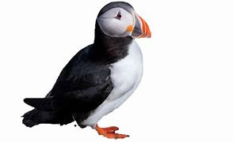

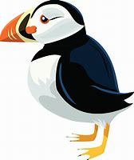


Puffins: Autumn 1
September 4th – October 20th
Weekly reminders
Monday
PE Kits to be in school. Weather appropriate
Indoor PE
Tuesday
Outdoor PE
Homework - due
Spelling test
Wednesday
Reading books changed
Friday
Homework - set
Please make sure reading books and reading diaries are in bags.
Please note these are subject to change.
Hello and welcome to Puffins first curriculum map for the new academic year. Here you will find a brief overview of the subjects and the content that we will be covering during the first part of the Autumn term. Our topic this half term is Amazing Me! You are invited to come and see our Portrait Gallery on Tuesday 17th October at 2.50pm.
English
We will start the term by looking at the text ‘Incredible You’ by Rhys Brissenden. It is a vibrant, engaging book with a fantastic message about recognising all of the incredible things that each of us can do. The work that we do around this text will culminate in the children creating their own ‘All About Me’ booklet.
We will then move on to ‘The Three Pigs’ and focus in on stories with familiar settings. During this unit the children will have the opportunity to work on their story writing skills.
Maths
This first half term will focus mainly on Place Value. The Year 1 children will be looking at recognising numbers, counting in groups and counting on from any given number, 1 more/less, comparing numbers and writing number names.
The Year 2 children will be counting in tens, partitioning tens and ones, working with numbers up to 100 and filling in numbers on the number line.

Slide 2

PE
Indoor - we will be looking at gymnastics with a focus on moving like animals.
Outdoor - this term we will work on throwing and catching skills.
R.E.
Our theme will be What did Jesus teach?
Our focus throughout this topic will be kindness.
PSHE
We will learn that some choices we make can make us feel good and others can make us feel sad.
History
In History we will be exploring family history and will be looking at changes that have been made in living memory. Our enquiry question is How is life as a child now different to a grandparent’s?
Science
We will be looking at animals and living things. Our focus will be the human body and our senses.
We will be beginning our longitudinal study about how the weather changes over the four seasons.
Art
In Art we will be creating our own self portraits and also looking at a wide range of self portraits from famous artists.
Computing
Our topic is called ‘Technology Around Us’ where we will locate examples of technology around us and explain how they help us.
Music
We will be singing action songs, rhymes and rhythmic chants. We will also be doing some body percussion and exploring instruments.
If you have any questions or concerns then please feel free to speak to me or email adminoffice@wherwell.hants.sch.uk and your message will be forwarded on.
Notes:
2

