Slide 1
Test Valley School –
Pupil Council Event 2018/19

Slide 2
Summary
Last Week we went to Test Valley School to talk about the UN Rights of a Child.
We met other councillors from years 3,4, 5 and 6 from some of the schools in our Cluster.
First we did “Speed Dating”
Once we finished, we went back to our table groups.
We talked about what we thought Children’s rights were and then we watched a video celebrating the 25th anniversary of the UN Rights of a Child.
We were given two sheets: one with the UN Children’s Rights and one with the Pupil Council Charter and we were asked to match the rights with the Charter.
Finally we wrote down our questions for the Test Valley Children about their school.

Slide 3
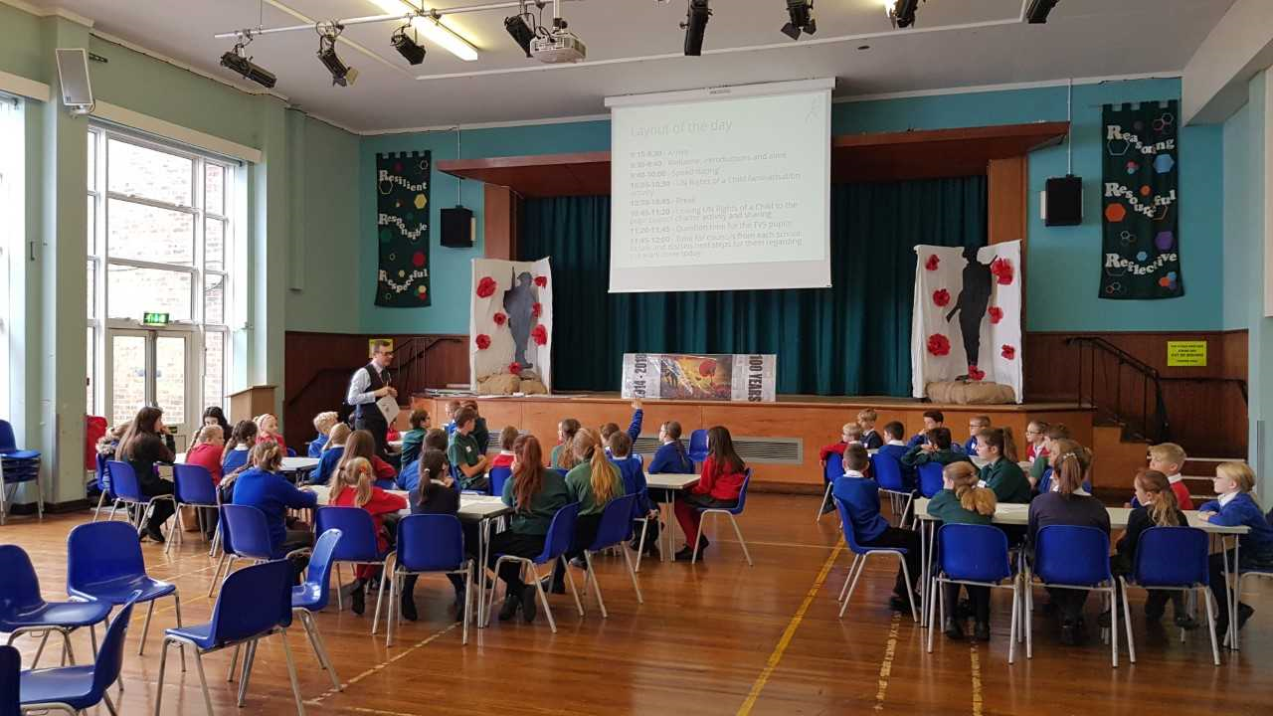
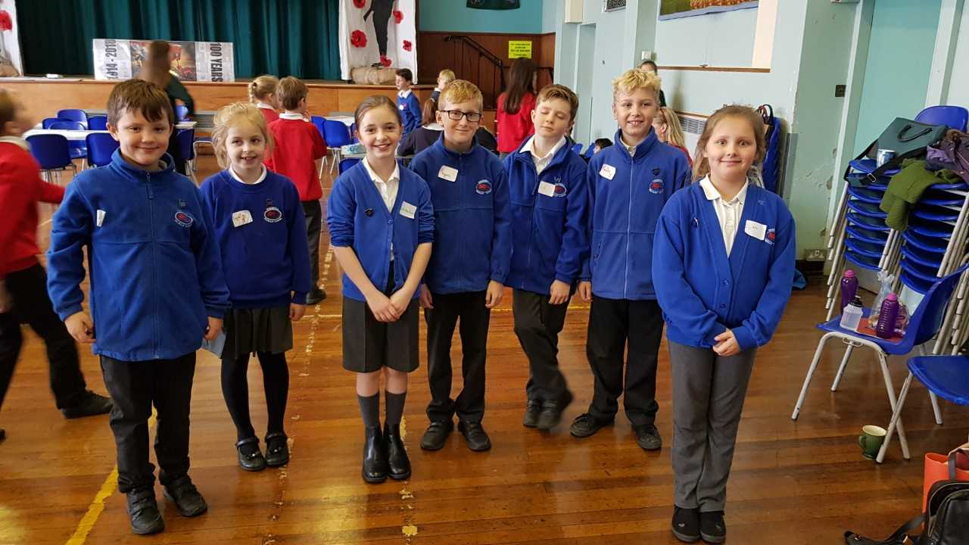

Slide 4
What is a Right?
A moral or legal entitlement to have or do something
The UN Children’s Rights, put together in 54 articles the Rights of every child.
There are 4 articles in the UN convention that are seen as special. They’re known as the “General Principles” and they help to interpret all the other articles and play a fundamental role in realising all the rights in the Convention for all children.
They are:
Non-discrimination (article 2)
Best interest of the child (article 3)
Right to life, survival and development (article 6)
Right to be heard (article 12)

Slide 5
Key Learnings
UN Children’s Rights have only been around for 25 years
These rights have been ratified by 195 countries around the world
Only Somalia and United States have not ratified them
These rights were put together to protect children
There are over 50 articles and here are some that we want to share…

